Slide 1
Information Security SEng 3084
Chapter One
Introduction

Slide 2
Presentation outline
Introduction and terminologies
The cause of insecurity.
Security goals
Security breach levels
The challenges of computer security
The OSI security architecture
Security attacks
Common security threats
Security services and mechanisms
Security techniques

Slide 3
Introduction and Terminology
Definition of Security:
This is the age of universal electronic connectivity, where the activities like hacking, viruses, electronic fraud are very common.
So security measures should be taken to solve such types of problems.
“The quality or state of being secure--to be free from danger” and to be protected from adversaries.
It is a continuous process of protecting an object from attack.
The object may be a person, an organization, or properties, files etc.

Slide 4
Introduction and Terminology
Definition of Security:
The term, Computer Security, refers to the protection afforded to an automated information system in order to attain the applicable objectives of preserving the integrity, availability, and confidentiality of information system resources (includes hardware, software, firmware, information/data, and telecommunications).
This definition introduces three key objectives, CIA traid (Integrity, availability, and confidentiality) that are at the heart of computer security.
Security is about
Threats (bad things that may happen, e.g. your money getting stolen)
Vulnerabilities (weaknesses in your defenses, e.g. your front door being made of thin wood and glass)
Attacks (ways in which the threats may be actualized, e.g. a thief breaking through your weak front door while you and the neighbors are on holiday)

Slide 5

Introduction and Terminology
Definition of Security:
Computer security is about provisions and policies adopted to protect information and property from theft, corruption, or natural disaster.
while allowing the information and property to remain accessible and productive to its intended users.
Security of computers against intruders (e.g. hackers) and malicious software (e.g. viruses).

Slide 6
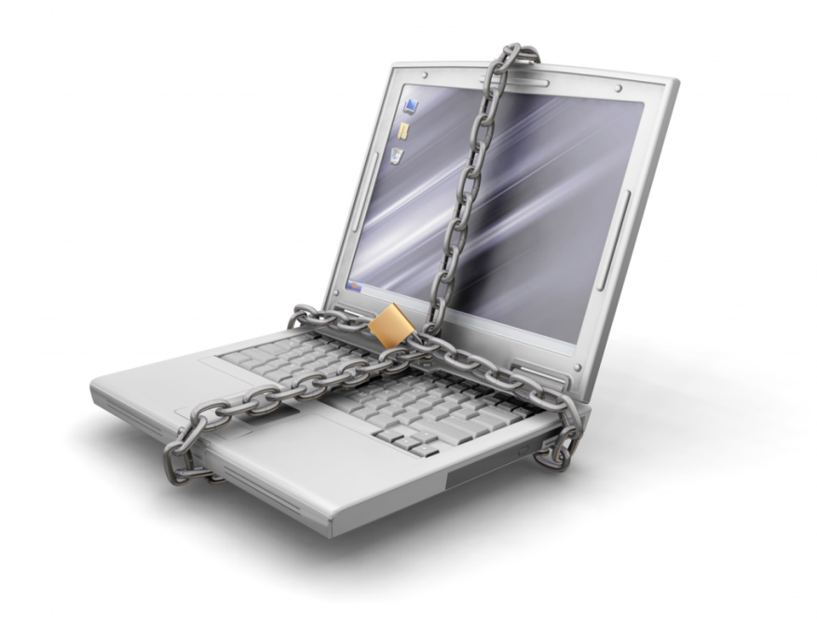
Introduction and Terminology
Definition of Security:
“The most secure computers are those not connected to the Internet and shielded from any interference”

Slide 7
Introduction and Terminology
Information Assurance (IA)
It is the study of how to protect your information assets from destruction, degradation, manipulation and exploitation., by insuring its confidentiality, integrity and availability.
How to recover should any of those happen.
It involves the actions taken to protect and defend information and information systems.
This includes providing for restoration of information systems by incorporating protection, detection and reaction capabilities.
IA is a multidisciplinary area of study and professional activity which aims to protect business by reducing risks associated with information and information systems by means of a comprehensive and systematic management of security countermeasures, which is driven by risk analysis and cost-effectiveness.

Slide 8
Introduction and Terminology
Information Assurance (IA)
The definition declares two main drivers behind security decisions:
Risk analysis - IA does not attempt to eliminate all risks, the risks should be prioritized according to the organization’s specifics, and reduced to an acceptable level.
Cost-effectiveness - IA does not attempt to achieve security at any price, but in a most efficient and cost-effective way.
Generally, Information Assurance is a broad field that there is no universally accepted definition.
Information assurance encompasses a broader scope than information security, network security, and computer security.

Slide 9
Introduction and Terminology
Information Assurance (IA)
The U.S Department of Defense (DoD) breaks down IA into three basic elements — people, technology, and operations.
People are the most crucial aspect of IA. The challenge is to provide the right amount and type of training to all the people and to develop a human resources strategy that brings the right people to bear at the right time and place.
Operation consists of two main aspects: system management and situation awareness. Operations also include the security procedures required to ensure that system defences quickly adapt in response to changing threats.
The element of Technology includes all tools /hardware or software/ which are used to protect information and information systems: within the network at large; at the enclave boundary; and within the computing environment of an enterprise.

Slide 10
Introduction and Terminology
Information Security
It refers to the processes and methodologies which are designed and implemented to protect information or data:-
From unauthorized access, use, misuse, disclosure, destruction, modification, or disruption.
Information can be printed, electronic, or any other form of confidential, private and sensitive information or data.
It is concerned with the confidentiality, integrity and availability of data regardless of the form the data may take: electronic, printed, or other forms.
It means protecting information and information systems from illegal operations.
Information security is also about working with employees and management to make sure that everyone is aware of current threats and how they can protect their information and systems.

Slide 11
Introduction and Terminology
Information Security
The terms information security, computer security and network security are frequently used interchangeably.
These fields are interrelated often and share the common goals of protecting the confidentiality, integrity and availability of information; however, there are some subtle differences between them.
Information security: refers to the processes and methodologies that are designed and implemented to protect print, electronic, or any other form of confidential, private and sensitive information or data from unauthorized access, use, misuse, disclosure, destruction, modification, perusal, inspection, recording or disruption.
Computer security: is the generic name for the collection of tools designed to protect the processed and stored data and to hinder hackers.
Network security: is the generic name for the collection of tools designed to protect data during their transmission over a collection of interconnected networks.

Slide 12
The Causes of insecurity
The insecurity of computer systems and networks goes much further than the well-known computer viruses, and has now become a priority.
In the networked world, the new generation of criminals does not need to have physical contact with the victim.
Data can be easily copied, transmitted, modified or destroyed.
As a result, the scene of crime is a particularly difficult one: there are no traces, identification of the culprits is nearly impossible, apprehension even more so and the legal framework does not make adequate provision for justice in this kind of crime.
The real-time nature of the Internet adds a further dimension to crime.
While many causes exist for security problems, at least three types of fundamental weaknesses open the door to security problems.
Technology weakness
Policy weakness
Configuration weakness

Slide 13
Computer Security… Vulnerabilities
Types of Vulnerabilities
Physical vulnerabilities (e.g. Computer can be stolen)
Natural vulnerabilities (e.g. Earthquake)
Hardware and Software vulnerabilities (e.g. Failures)
Media vulnerabilities (e.g. Hard disks can be stolen)
Communication vulnerabilities (e.g. Wires can be tapped)
Human vulnerabilities (e.g. Insiders)
Computer Security… Consequences of risks
Failure/End of service.
Reduction of QoS (quality of service), down to Denial of Service (DoS)
Trust decrease from partners (client, providers, share-holders)
Human consequences (personal data, sensitive data - medical, insurances, …)

Slide 14

Security Goals
Security is expressed in terms of
Confidentiality (Privacy)
It requires that the message must only be viewed and accessible by authorized parties.
It also requires that the system should verify the identity of a user.
Only authorized people or systems can access protected data which refers to Data Confidentiality.
The other confidentiality is in terms of Privacy, which assures that individuals control or influence what information be collected and stored and by whom and to whom that information may be disclosed
Measures how secure is the information?
How secured the data need to be?
Best methods:
Physical protection
Locking the door, fence, security camera…
Electronic protection
Encryption, password, firewall, authentication…
Failure of confidentiality occurs when someone can obtain and view the data.
Notes:
message must only be viewed and accessible by authorized parties.
verify the identity of a user.
Data Confidentiality: people or systems can access protected data.
Privacy: assures (control) or influence what information be collected and stored.

Slide 15
Security Goals
Security is expressed in terms of:
Confidentiality (Privacy)
An organization needs to guard against malicious actions that endanger the confidentiality of its information.
Confidentiality not only applies to the storage of information but also applies to the transmission of information.
When we send a piece of information to be stored in a remote computer or when we retrieve a piece of information from a remote computer, we need to conceal (cover) it during transmission.
There are many countermeasures that organizations put in place to ensure confidentiality.
Passwords, access control lists and authentication procedures use software to control access to resources, volume and file encryption, and Unix file permissions.
These access control methods are complemented by the use encryption to protect information that can be accessed despite the controls, such as emails that are in transit.
Notes:
An organization needs to guard against malicious actions that endanger the confidentiality of its information.
Confidentiality not only applies to the storage of information but also applies to the transmission of information.

Slide 16
Security Goals
Security is expressed in terms of:
Integrity
Integrity means that changes need to be done only by authorized entities and through authorized mechanisms.
For example, in a bank when a customer deposits or withdraws money, the balance of his account needs to be changed.
Information needs to be changed constantly.
Integrity violation is not necessarily the result of a malicious act; an interruption in the system, such as a power surge may also create unwanted change in some information.
Integrity covers two related concepts these are Data integrity which Assures that information (both stored and in transmitted packets) and programs are changed only in a specified and authorized manner.
The other is System integrity which Assures that a system performs its intended function in an unimpaired (undamaged) manner, free from deliberate or inadvertent unauthorized manipulation of the system.
Notes:
Integrity means that changes need to be done only by authorized entities and through authorized mechanisms.
Data integrity
System integrity

Slide 17
Security Goals
Security is expressed in terms of:
Integrity
It requires that messages should be modified or altered only by authorized parties.
Modification includes writing, changing, deleting, and creating the message that is supposed to be transmitted across the network.
Integrity guarantees that no modification, addition, or deletion is done to the message.
Failure of integrity occurs if someone modifies the data being stored in or transmit.

Slide 18
Security Goals
Security is expressed in terms of:
Availability (Denial of Service)
The information created and stored by an organization need to be available to authorized entities.
Availability measures protect timely and un-interrupted access to the system.
It requires that computer and network assets are only available to authorized parties.
Computer and network should provide all the designated services in the presence of all kinds of security attack.
threats to availability are mostly non-malicious in nature, its hardware failures, unscheduled software downtime and network bandwidth issues.
How much uptime is the system providing the service?
Is the data accessible by users at all times?
Failure of availability occurs if the data cannot be accessed by the end users.

Slide 19
Security Goals
Security is expressed in terms of:
Non-repudiation
Non-repudiation prevents either sender or receiver from denying a transmitted message.
This capability is crucial to e-commerce.
Without it an individual or entity can deny that he, she or it is responsible for a transaction, therefore not financially liable.
Authentication
Authentication is a foundations of security.
In its absence, security properties can be violated.
Assures that a communication is authentic.
The property of being genuine and being able to be verified and trusted; confidence in the validity of a transmission, a message, or message originator.
This means verifying that users are who they are and that each input arriving at the system came from a trusted source.

Slide 20
Security breach levels
There are three levels of impact on organizations or individuals should there be a breach of security (i.e., a loss of confidentiality, integrity, or availability).
These levels are: Low level, moderate level and high level.
Low: The loss could be expected to have a limited adverse effect on organizational operations, organizational assets, or individuals.
A limited adverse effect means that, for example, the loss of confidentiality, integrity, or availability might:
Cause a degradation in mission capability to an extent and duration that the organization is able to perform its primary functions, but the effectiveness of the functions is noticeably reduced.
Result in minor damage to organizational assets.
Result in minor financial loss; or
Result in minor harm to individuals.

Slide 21
Security breach levels
Moderate: The loss could be expected to have a serious adverse effect on organizational operations, organizational assets, or individuals.
A serious adverse effect means that, for example, the loss might:
Cause a significant degradation in mission capability to an extent and duration that the organization is able to perform its primary functions, but the effectiveness of the functions is significantly reduced;
Result in significant damage to organizational assets;
Result in significant financial loss; or
Result in significant harm to individuals that does not involve loss of life or serious, life threatening injuries.

Slide 22
Security breach levels
High: The loss could be expected to have a severe or catastrophic adverse effect on organizational operations, organizational assets, or individuals.
A severe or catastrophic adverse effect means that, for example, the loss might:
Cause a severe degradation in or loss of mission capability to an extent and duration that the organization is not able to perform one or more of its primary functions;
Result in major damage to organizational assets;
Result in major financial loss; or
Result in severe or catastrophic harm to individuals involving loss of life or serious, life threatening injuries.

Slide 23
The Challenges of Computer Security
Computer and network security is both fascinating and complex. Some of the reasons follow:
Security is not as simple as it might first appear to the novice. The requirements seem to be straightforward; indeed, most of the major requirements for security services can be given self explanatory, one-word labels: confidentiality, authentication, nonrepudiation, or integrity. But the mechanisms used to meet those requirements can be quite, complex, and understanding them may involve rather subtle reasoning.
In developing a particular security mechanism or algorithm, one must always consider potential attacks on those security features. In many cases, successful attacks are designed by looking at the problem in a completely different way, therefore exploiting an unexpected weakness in the mechanism.
Because of point 2, the procedures used to provide particular services are often counter intuitive. Typically, a security mechanism is complex, and it is not obvious from the statement of a particular requirement that such elaborate measures are needed. It is only when the various aspects of the threat are considered that elaborate security mechanisms make sense.

Slide 24
The Challenges of Computer Security
Computer and network security is both fascinating and complex. Some of the reasons follow:
Having designed various security mechanisms, it is necessary to decide where to use them. This is true both in terms of physical placement (e.g., at what points in a network are certain security mechanisms needed) and in a logical sense (e.g., at what layer or layers of an architecture such as TCP/IP should mechanisms be placed).
Security mechanisms typically involve more than a particular algorithm or protocol. They also require that participants be in possession of some secret information (e.g., an encryption key), which raises questions about the creation, distribution, and protection of that secret information. There also may be a reliance on communications protocols whose behaviour may complicate the task of developing the security mechanism. For example, if the proper functioning of the security mechanism requires setting time limits on the transit time of a message from sender to receiver, then any protocol or network that introduces variable, unpredictable delays may render such time limits meaningless.

Slide 25
The Challenges of Computer Security
Computer and network security is both fascinating and complex. Some of the reasons follow:
Computer and network security is essentially a battle of wits between a perpetrator (criminal) who tries to find holes and the designer or administrator who tries to close them. The great advantage that the attacker has is that he or she need only find a single weakness, while the designer must find and eliminate all weaknesses to achieve perfect security.
There is a natural tendency on the part of users and system managers to perceive little benefit from security investment until a security failure occurs.
Security requires regular, even constant, monitoring, and this is difficult in today’s short-term, overloaded environment.
Security is still too often an afterthought to be incorporated into a system after the design is complete rather than being an integral part of the design process.
Many users and even security administrators view strong security as an impediment to efficient and user-friendly operation of an information system or use of information.

Slide 26
The OSI Security Architecture
The OSI security architecture focuses on security attacks, mechanisms, and services. These can be defined briefly as
Security attack: Any action that compromises the security of information owned by an organization.
Security mechanism: A process (or a device incorporating such a process) that is designed to detect, prevent, or recover from a security attack.
Security service: A processing or communication service that enhances the security of the data processing systems and the information transfers of an organization.
The services are intended to counter security attacks, and they make use of one or more security mechanisms to provide the service.

Slide 27
Security Attacks
Security attacks can be characterized as the different sorts of systematic activities aimed at decreasing or corrupting the security.
From this perspective, an attack can be defined as a systematic threat generated by an entity in an artificial, deliberate and intelligent way.
The terms threat (a possible danger that might exploit a vulnerability) and attack (a deliberate attempt to evade security services) are commonly used to mean more or less the same thing.
Conceptually, the security attacks can be classified into two types that are active and passive attacks where the attacker gains illegal access to the system’s resources.
Passive attacks
Active attacks

Slide 28
Security Attacks
Passive attacks
A passive attack attempt to learn or make use of the information without changing the content of the message and disrupting the operation of the communication.
A passive attack is one where the attacker only monitors the communication channel.
A passive attacker only threatens the confidentiality of data.
Due to passive attack, there is no any harm to the system.
The goal of the opponent is to obtain information that is being transmitted.
Passive attacks are in the nature of eavesdropping on, or monitoring of, transmissions.
The attacker observes the content of messages or copy the content of messages.
The eavesdropper does not make any changes to the data or the system.

Slide 29
Security Attacks
Passive attacks
Passive attacks are very difficult to detect.
Message transmission apparently normal.
No alteration of the data.
Neither the sender nor receiver is aware that a third party has read the messages or observed the traffic pattern.
Emphasis on prevention rather than detection by means of encryption.
These types of attacks threaten the confidentiality of information.
Two types of passive attacks are related to message contents and traffic analysis:

Slide 30
Security Attacks
Passive attacks
Eavesdropping / Snooping: (secretly listen to a communication)
The majority of network communications occur in an unsecured or "clear text" format, which allows an attacker who has gained access to data paths in the network to “listen in” or interpret (read) the data exchanged over the network.
The ability of an eavesdropper to monitor the network is generally the biggest security problem.
Without strong encryption services that are based on cryptography, the data can be read by others as it traverses the network.
Snooping refers to unauthorized access to or interception of data.
For example, a file transferred through the internet may contain confidential information.
An unauthorized entity may intercept the transmission and use the contents for his own benefit.

Slide 31
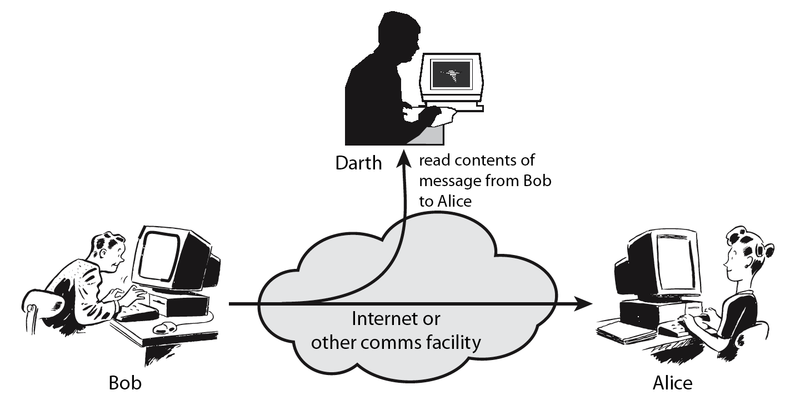
Security Attacks
Passive attacks
Eavesdropping / Snooping: (secretly listen to a communication)

Slide 32
Security Attacks
Passive attacks
Traffic Analysis:
An unauthorized entity can obtain some other type information by monitoring online traffic.
For example, he can find the email id of the sender or the receiver, he can collect pairs of request and response to help him guess the nature of transaction Traffic analysis:
It refers to the process of intercepting and examining messages in order to deduce information from patterns in communication.
It can be performed even when the messages are encrypted and cannot be decrypted.
In general, the greater the number of messages observed, or even intercepted and stored, the more can be inferred from the traffic.

Slide 33
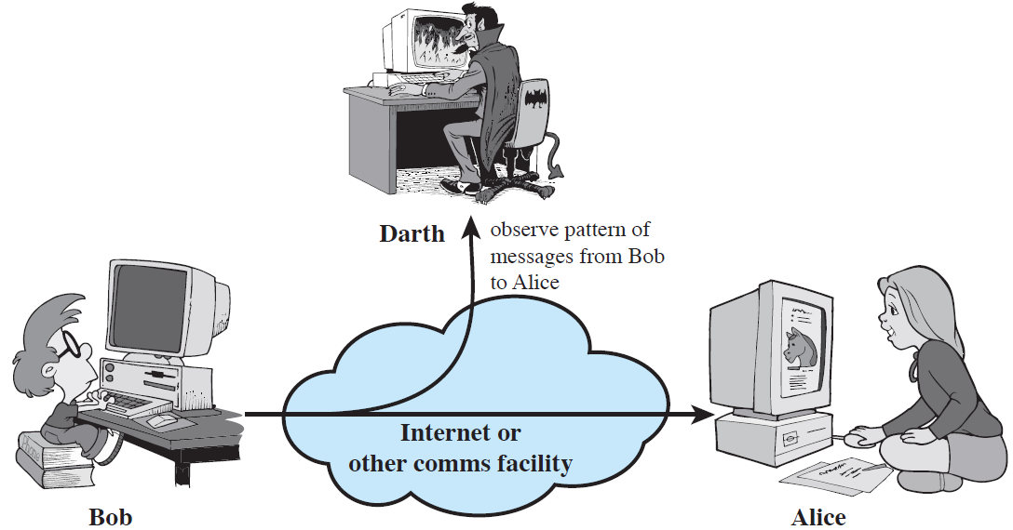
Security Attacks
Passive attacks
Traffic Analysis:

Slide 34
Security Attacks
Active attacks
Attempts to interrupt, modify, delete, or fabricate messages or information thereby disrupting normal operation of the network.
Active attacks try to alter system resources or affect their operation.
Modification of data, or creation of false data
An active attacker threatens data integrity, authentication as well as confidentiality.
The most important thing is that, in active attack, Victim gets informed about the attack.
Active attacks involve some modification of the data stream or the creation of a false stream and can be divided into six categories:

Slide 35
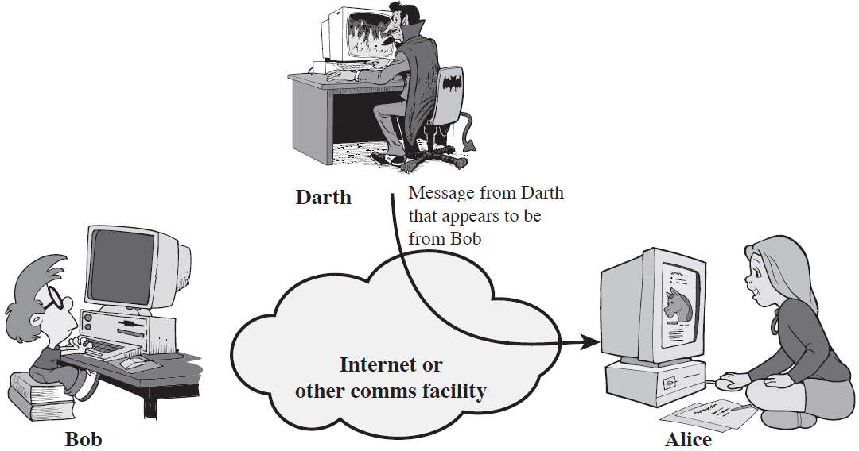
Security Attacks
Active attacks
Masquerade: It is a type of attack where the attacker pretends to be an authorized user of a system in order to gain access to it or to gain greater privileges than they are authorized for.
Masquerading or spoofing, happens when the attacker impersonates somebody else.
For example, the attacker might steal the bank card and PIN of a customer and pretend that he is that customer.

Slide 36
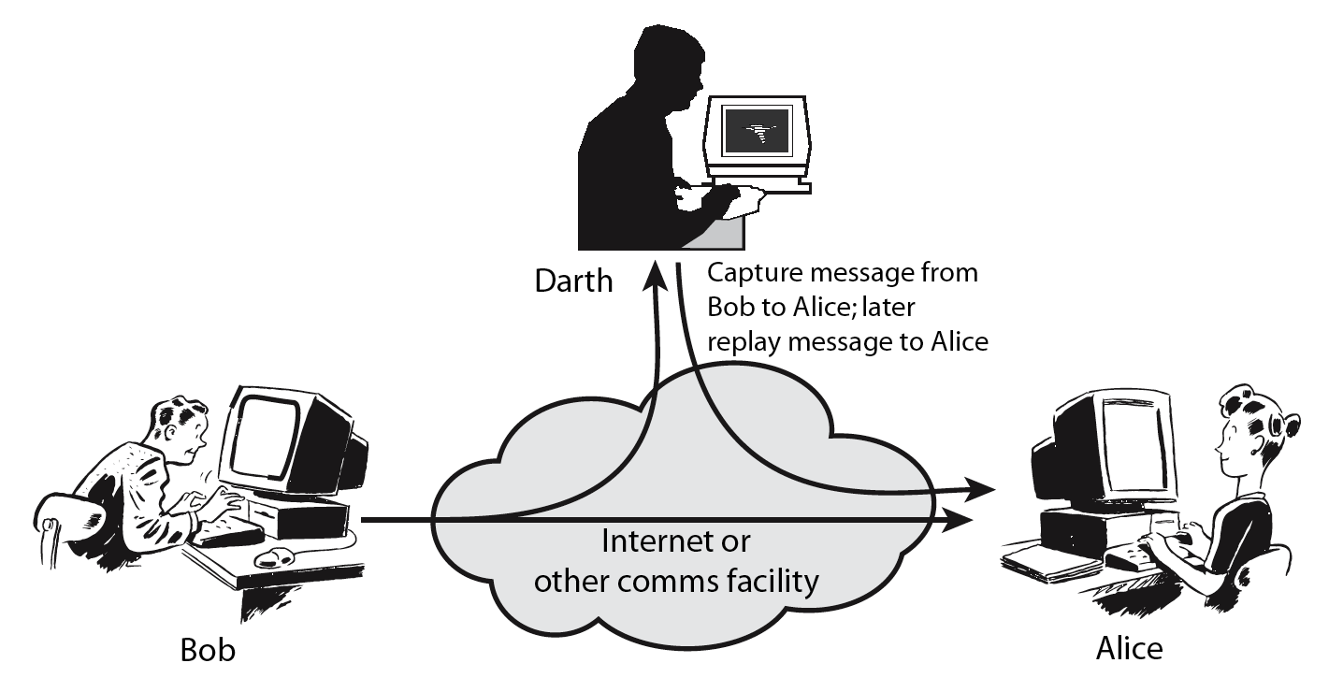
Security Attacks
Active attacks
Replay: In this kind of attack, a valid data transmission is maliciously or fraudulently repeated or delayed.
This is carried out either by the originator or by an adversary (opponent) who intercepts the data and retransmits them, possibly as part of a masquerade attack.
The attacker obtains a copy of a message sent by the user and later tries to reply it.
For example, a person sends a request to his bank to ask for payment to the attacker who has done job for him. The attacker intercepts the message and sends it again to receive another payment from the bank.

Slide 37
Security Attacks
Active attacks
Modification of messages: The attacker removes a message from the network traffic, alters it, and reinserts it.
Modification: After intercepting or accessing information, the attacker modifies the information to make it beneficial to himself. For example, a customer sends a message to a bank to do some transaction, and the attacker intercepts the message and changes the type of transaction to benefit him.

Slide 38
Security Attacks
Active attacks
Repudiation: It is performed by one of the parties in the communication: the sender or the receiver.
The sender of the message might later deny that he has sent the message; the receiver of the message might later deny that he has received the massage.
For example, customer ask his Bank “To transfer an amount to someone” and later on the sender(customer) deny that he had made such a request. This is repudiation.

Slide 39
Security Attacks
Active attacks
Denial of service (DoS)
In a DoS attack, an attacker attempts to prevent legitimate users from accessing information or services.
This attack threatens availability.
It may slow down or totally interrupt the service of a system.
The attacker can use several strategies to achieve this.
He may send so many fake (bogus) requests to a server that the server crushes because of heavy load.
The attacker may intercept and delete a server’s response to a client, making the client believe that the server is not responding.

Slide 40
Security Attacks
Active attacks
Denial of service (DoS)

Slide 41
Security Attacks
Active attacks
Advanced Persistent Threat (APT): It is a network attack in which an unauthorized person gains access to a network and stays there undetected for a long period of time.
The intention of an APT attack is to steal data rather than cause damage to the network or organization.
APT attacks target organizations in sectors with high-value information, such as national defense, manufacturing and the financial industry.
Generally:-
An active attack usually requires more effort and often more dangerous implication.
When the hacker attempts to attack, the victim gets aware of it.
The active attacks can be in the form of interruption, modification and fabrication.

Slide 42
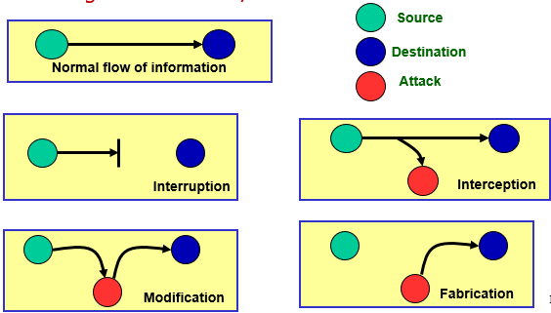
Security Attacks
Active attacks
Interruption: An attack on availability
Modification: An attack on integrity
Fabrication: An attack on authenticity, cause DOS

Slide 43
Security Attacks
Comparison between Active attacks and passive attacks
BASICS FOR COMPARISION | ACTIVE ATTACK | PASSIVE ATTACK
Basic | Tries to change the system resources or affect their operation. | Tries to read or make use of information from the system but does not influence system resources.
Modification in information | Occurs | Does not occur
Harm to the system | Always causes damage to the system. | Always causes damage to the system.
Threat to | Integrity and availability | Confidentiality
Attack awareness | The entity (victim) gets informed about the attack. | The entity is unaware of the attack.
Task performed by the attacker | The transmission is captured by physically controlling the portion of a link | Just need to observe the transmission.
Emphasis on | Detection | Prevention

Slide 44
Security Services and Mechanism
Security Services:
ITU-T (International Telecommunication Union – Telecommunication Standardization Sector (ITU-T) has defined five services relating to the security goals and attacks:
Data Confidentiality:
This service is designed to protect data from disclosed attacks.
The services encompasses confidentiality of the whole message or part of a message and also protection against traffic analysis.
It is designed to protect against snooping and traffic analysis attack .
Data Integrity
This is designed to protect the data from modification, insertion, deletion, and replaying by an adversary.
It may protect the whole message or the part of the message.

Slide 45
Security Services and Mechanism
Security Services:
ITU-T has defined five services relating to the security goals and attacks:
Authentication
This service provides the authentication of the party at the other end of the line.
In connection-oriented communication, it provides authentication of the sender or receiver during the connection establishment.
In connectionless communication, it authenticates the source of the data.
Access Control
This service provides protection against unauthorized access to data.
access includes reading, writing, modifying, executing programs and so on.
Non-repudiation: This service protects against repudiation by either the sender or the receiver of the data. In non-repudiation with proof of the origin, the receiver of the data can later prove the identity of the sender if denied. In non-repudiation with proof of the delivery, the sender of the data can later prove that data were delivered to the intended recipient

Slide 46
Security Services and Mechanism
(ITU-T) provides some security mechanisms to implement those services.
Security Mechanism:
Security mechanism is a process that implements security services based on hardware (technical), software (logical), physical or administrative approach.
Security mechanisms support the security services and execute specific activities for the protection against attacks or attack results.
The security mechanisms are divided into those that are implemented in a specific protocol layer and those that are not specific to any particular protocol layer or security service.
Security Mechanisms that are specific to a particular OSI security service or protocol layer:

Slide 47
Security Services and Mechanism
(ITU-T) provides some security mechanisms to implement those services.
Security Mechanism:
Encipherment
is a mechanism aimed at protecting a message’s information content by using mathematical algorithms that transform data into a form that is not readable by unauthorized subjects.
This is used either to protect the confidentiality of data units and traffic flow information or to support or complement other security mechanisms.
This is hiding or covering data can provide confidentiality.
Two techniques, cryptography and steganography, are used for enciphering.

Slide 48
Security Services and Mechanism
(ITU-T) provides some security mechanisms to implement those services.
Security Mechanism:
Digital signature
This is a means by which the sender can electronically sign the data and the receiver can electronically verify the signature.
The receiver uses the sender’s public key to prove that the message is indeed signed by the sender who claims to have sent the message.
Public and private keys can be used.
Access Control covers a variety of mechanisms that enforce access rights to resources. This mechanism involves authorization to access some resources. Access control used methods to prove that a user has access right to the data or resources owned by a system. Examples of proofs are passwords and PINs.

Slide 49
Security Services and Mechanism
(ITU-T) provides some security mechanisms to implement those services.
Security Mechanism:
Data integrity
Covers a variety of mechanisms used to assure the integrity of a data unit or stream of data units.
The data integrity mechanism appends to the data a short check value that has been created by a specific process from the data itself.
Data integrity is preserved by comparing check value received to the check value generated.
Authentication Exchange
is a mechanism intended to ensure the identity of an entity by means of information exchange.
Two entities exchange some messages to prove their identity to each other.

Slide 50
Security Services and Mechanism
(ITU-T) provides some security mechanisms to implement those services.
Security Mechanism:
Traffic Padding
This means inserting some bogus (fake) data into the data traffic to thwart adversary’s attempt to use the traffic analysis.
Routing Control
This means selecting and continuously changing different available routes between the sender and the receiver to prevent the opponent from eavesdropping on a particular route.
Notarization
This means selecting a third trusted party to control the communication between two entities. This can be done to prevent repudiation.

Slide 51
Security techniques
The actual implementation of security goals needs some techniques.
Two techniques are prevalent today: Cryptography and Steganography
i. Cryptography: involves the following mechanisms.
Symmetric-key ( secret key cryptography)
An entity can send a message to another entity over an insure channel with the assumption that an adversary can not understand the content by simply snooping over the channel.
The sender encrypts the message using encryption algorithm.
The receiver decrypts the message using decryption algorithm.
A single secret key is used for both encryption and decryption.
E.g. DES and AES

Slide 52
Security techniques
Two techniques are prevalent today: Cryptography and Steganography
i. Cryptography: involves the following mechanisms.
b. Asymmetric-key (public key cryptography)
first there are two key instead of one: one public key and the other private key.
the sender first encrypts the message by using the receiver ‘s public key.
to decrypt the message, the receiver uses his own private key.
E.g. RSA, Diffie-Hellman key exchange.

Slide 53
Security techniques
Two techniques are prevalent today: Cryptography and Steganography
ii. Steganography
Cryptography is secret writing, steganography is covered writing.
Steganography means concealing the message itself by covering it with something else.
E.g. image over text

Slide 54
Review Questions
Define what information, computer and network security mean?
Discuss about goals of security
Discuss about the attacks in relation with goals.
What do we mean by an attack is active or passive? Give examples for each.
Discuss on the security services provided by ITU-T organization.
Discuss on the security mechanisms provided by ITU-T organization.
What are the actual techniques that can be implemented for security? Discuss about them.

Slide 55
Thank you
???

